Slide 1
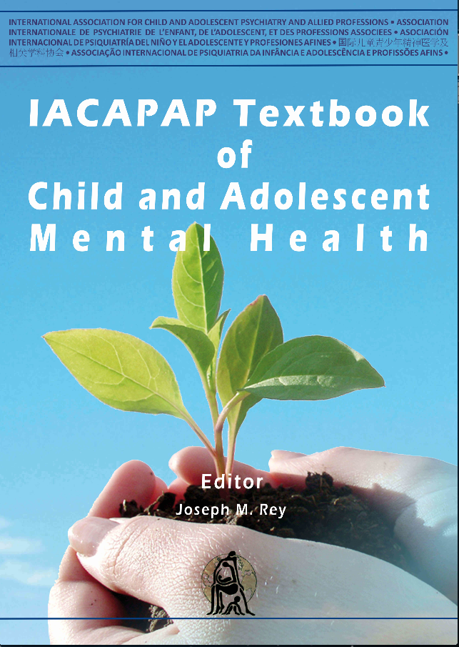
MOOD DISORDERS
Chapter E.1
Depression in Children and Adolescents
Joseph M Rey, Tolulope T Bella-Awusah & Jing Liu
DEPRESSION IN CHILDREN AND
ADOLESCENTS
Companion Powerpoint Presentation
Adapted by Julie Chilton

Slide 2
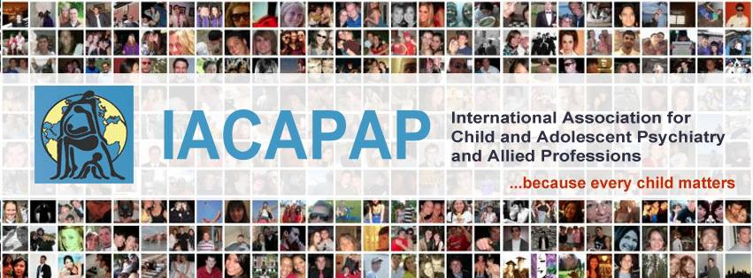
The “IACAPAP Textbook of Child and Adolescent Mental Health” is available at the IACAPAP website http://iacapap.org/iacapap-textbook-of-child-and-adolescent-mental-health Please note that this book and its companion powerpoint are: · Free and no registration is required to read or download it · This is an open-access publication under the Creative Commons Attribution Non- commercial License. According to this, use, distribution and reproduction in any medium are allowed without prior permission provided the original work is properly cited and the use is non-commercial.

Slide 3
Depression in Children and Adolescents Learning objectives
Definition
Epidemiology
Age of Onset and Course
Subtypes of Depression
Etiology and Risk Factors
Comorbidity
Diagnosis
Differential Diagnosis
Rating Scales
Treatment
Cross Cultural Perspectives
Barriers to Care
Prevention
Notes:
By the end of this presentation, you should understand the following about depression in children and adolescents

Slide 4
Depression in Children and Adolescents The Basics
Definition
Core symptoms
Associated symptoms
Variations
Appropriate terms
Notes:
--episodic, recurring disorder characterized by
persistent and pervasive sadness or unhappiness, loss of enjoyment
of everyday activities, irritability, and associated symptoms such as
negative thinking, lack of energy, difficulty concentrating, and appetite and sleep
Disturbances
--Core symptoms: Persistent and pervasive sadness or unhappiness, Loss of enjoyment of everyday activities. Irritability, Persistent and pervasive sadness or unhappiness, Loss of enjoyment of everyday activities, Irritability
--Associated symptoms: Negative thinking andlow self-esteem, Hopelessness, Unwarranted ideas of guilt, remorse or
Worthlessness, Suicidal thoughts or thoughts of death, Lack of energy, increased fatigability, diminished activity, Difficulty concentrating, Appetite disturbance (decrease or increase), Sleep problems (insomnia or
Hypersomnia)
--various subtypes of depression are identified on the basis
of symptom severity, pervasiveness, functional impairment, or the presence or
absence of manic episodes or psychotic phenomena
--terms “depression,” “depressive episode,” “depressive disorder” and
“clinical depression” will be used throughout the chapter to mean what DSM-IV
defines as “major depressive episode” or “major depressive disorder,” and ICD-
10 “depressive episode” and “recurrent depressive disorder.”

Slide 5
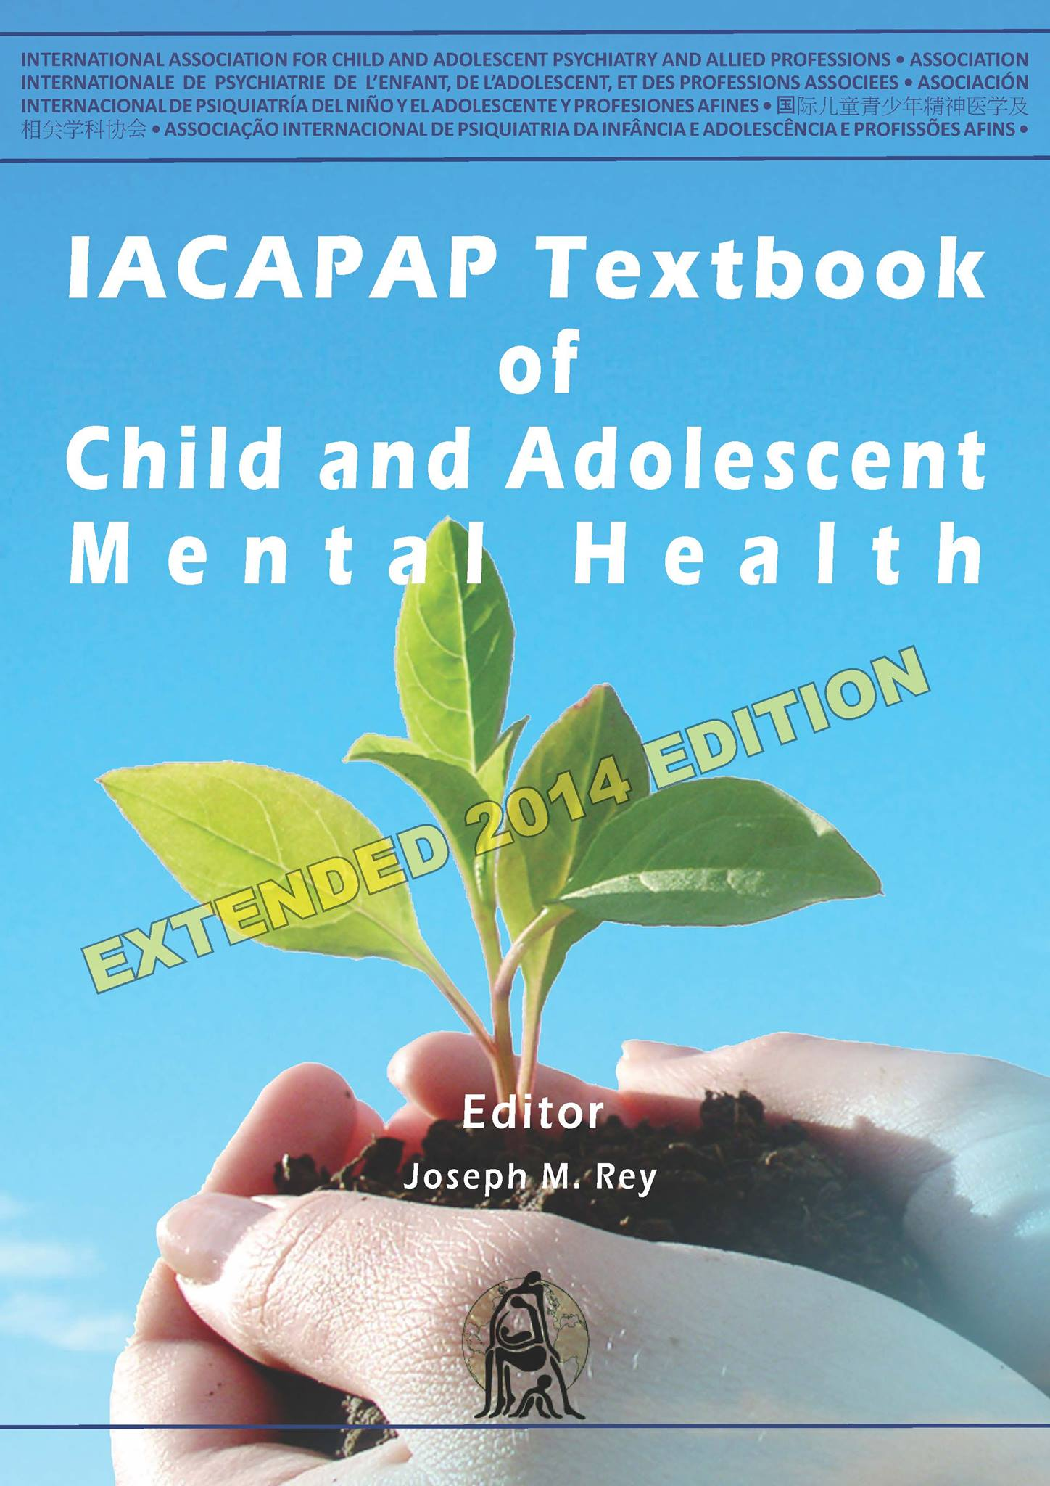
Depression in Children and Adolescents Epidemiology
Pre-pubertal children: 1-2%
Adolescents: 5%
Cumulative prevalence
Girls: 12%
Boys: 7%
Notes:
Prevalence varies depending on the population (e.g., country), the period
considered (e.g., last three months, last year, lifetime), informant (e.g., parent, child,
both), and criteria used for diagnosis. Most studies concur that about 1% to 2% of
pre-pubertal children and about 5% of adolescents suffer from clinically significant
depression at any one time. The cumulative prevalence (accumulation of new cases
in previously unaffected individuals, also known as lifetime prevalence) is higher.
For example, by the age of 16 years 12% of girls and 7% of boys would have had a
depressive disorder at some time in their lives (Costello et al. 2003).

Slide 6
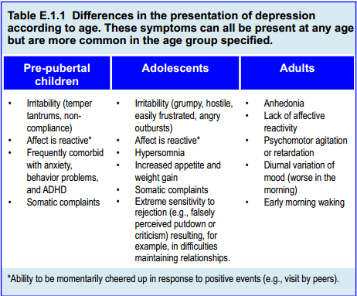
Depression in Children and Adolescents Differences According to Age

Slide 7
Depression in Children and Adolescents Course
Recurring, spontaneously remitting
Average episode: 7-9 months
40% probability of recurrence in 2 years
60% likelihood in adulthood
Predictors of recurrence:
poorer response, greater severity, chronicity, previous
episodes, comorbidity, hopelessness, negative cognitive style,
family problems, low SES, abuse or family conflict
Notes:
--clinical depression in youth follows a
recurring course. An episode of depression in clinically referred patients lasts 7 to
9 months on average, but it can be shorter in non-referred community samples.
That is, depressive episodes are, on average, a spontaneously remitting illness.
Conversely, there is a 40% probability of recurrence within 2 years. Recurrence
is high even after treatment. For example, participants in the 5-year follow up of
the Treatment of Adolescent Depression Study (TADS) showed that although the
immense majority (96%) of patients recovered from the index episode, after five years almost half (46%) had a recurrence (Curry et al., 2010).
--The likelihood of further episodes in adulthood is up to 60% (Birmaher et
al., 1996). Thus, depressive illness should optimally be conceptualized as a chronic
condition with remissions and recurrences. This has important implications for
management, which should seek not only to reduce the duration of the depressive
episode and lessen its consequences but also to prevent recurrences. Predictors
of recurrence include poorer response to treatment, greater severity, chronicity,
previous episodes, comorbidity, hopelessness, negative cognitive style, family
problems, low socioeconomic status, and exposure to abuse or family conflict
(Curry et al., 2010).

Slide 8
TYPES OF DEPRESSION
Depression in Children and Adolescents Subtypes of Depression
UNIPOLAR
Depression
BIPOLAR disorder
Manic
OR
Hypomanic
Non-melancholic
Melancholic
Psychotic
Anhedonia
Lack of reactivity
Worse in morning
Early morning awakening
Psychomotor retardation or agitation
Anorexia or weight loss
Inappropriate or excessive guilt
Mild
Moderate
Severe

Slide 9
Depression in Children and Adolescents Subtypes
Catatonic depression
Post-psychotic depression
Premenstrual dysphoric disorder
Seasonal depression
Mood disorder NOS
Adjustment disorder with depressed mood
Minor depression
Unipolar depression
Bipolar depression
Psychotic depression
Melancholic depression
Dysthymic disorder
Double depression
Notes:
--Unipolar depression Depression without history of a manic, mixed or hypomanic episode.
--Bipolar depression When there is history of at least one non drug-induced manic, hypomanic or
mixed episode.
--Psychotic depression The young person displays hallucinations or delusions in addition to
symptoms of major depression in the absence of other psychotic disorder.
--Melancholic depression, major depression with melancholic features, or melancholia
Episodes are characterized by prominent neurovegetative changes such
as weight loss, psychomotor retardation, marked sleep disturbance, diurnal
mood variation, early morning waking and lack of reactivity. Melancholic
depression is largely equivalent to “endogenous” depression.
--Dysthymic disorder or dysthymia A chronically depressed mood for at least one year but not severe enough to qualify for a diagnosis of depression; symptom-free intervals last less than
two months
--Double depression The depressive episode occurs in a patient already suffering from dysthymia.
--Catatonic depression When the mood disorder presents with symptoms of stupor.
--Post-psychotic depression When it occurs in the course of schizophrenia, often after resolution of the
florid psychotic symptoms
--Premenstrual dysphoric disorder Premenstrual mood changes—dysphoria, tension, irritability, hostility, and labile mood—that mimic depression. Its nature and validity are still being
argued.
--Seasonal depression, major depression with seasonal pattern,
seasonal affective disorder. The beginning and remission of major depression follow a pattern (for at
least two years) related to specific times of the year, usually onset during autumn or winter and remission in spring.
--Mood disorder not otherwise specified (NOS) Significant mood symptoms and impairment that do not meet criteria for a specific mood disorder often due to mixed presentations (e.g., depressive
and manic symptoms).
--Adjustment disorder with depressed mood. Clinically significant depressive symptoms or impairment occur within three months of identifiable stressors and do not meet criteria for major depression
or bereavement. It is expected that symptoms will disappear within six months once stressors have ceased.
--Minor depression, subsyndromal depression, subclinical depression. Depressive symptoms fall short of meeting the criteria for depression (e.g., one core symptom, and one to three associated symptoms, and very mild disability

Slide 10
Depression in Children and Adolescents Etiology
Genetics
Prenatal factors
Family relationships
Parental depression*
Cognitive style
Stressful life events
Lack of parental care
Notes:
In summary, depression in youth appears to be the result of complex
interactions between biological vulnerabilities and environmental influences.
Biological vulnerabilities may result from children’s genetic endowment and from
prenatal factors. Environmental influences include children’s family relationships,
cognitive style, stressful life events, school and neighborhood characteristics.
*Parental depression is the most consistently replicated risk factor for depression
in the offspring. Stressful life events—especially losses—may increase the risk for
depression; this risk is higher if children process loss events (or other stressful life
events) using negative attributions. Parental lack of care and rejection may also be
relevant.

Slide 11
Depression in Children and Adolescents Comorbidity
Anxiety disorders
Post Traumatic Stress Disorder
Conduct problems
Attention Deficit Hyperactivity Disorder
Obsessive Compulsive Disorder
Learning difficulties
Notes:
An epidemiological study
(Costello et al, 2003) showed that in a three-month period, 28% of the young
people diagnosed with a depressive disorder also had an anxiety disorder, 7%
ADHD, 3% conduct disorder, 3% oppositional defiant disorder and 1% substance
use disorder. The practical implication is that establishing whether a child shows
symptoms of one condition (e.g., depressive illness) is only a first step in the
evaluation; clinicians ought to enquire for symptoms of other conditions as well.
The link between depression and anxiety is well-known because depressive
and anxiety symptoms often coexist and individuals frequently experience
depressive and anxiety episodes at different times in their lives. Suffering from
a depressive episode not only increases the risk of further depressive episodes
(homotypic continuity) but also of anxiety disorders (heterotypic continuity).

Slide 12
Depression in Children and Adolescents Suicidal Behavior
Suicidal thoughts:
1/6 girls
1/10 boys
100:1 ratio of attempts to completions
60% depressed youth have thoughts of suicide
30% depressed youth make a suicide attempt
Risk factors: family history, previous attempts,
comorbidities, aggression, impulsivity, access to lethal means, negative life events
Notes:
Suicide is one of the leading causes of death in adolescents worldwide.
For each completed suicide in adolescents, there are about 100 reported suicide
attempts. Suicidal thoughts are common among the young; about one in six girls
aged 12 to 16 reports having them in the previous six months (one in ten for boys)
but rates in clinic samples are much higher. While suicide is the result of complex
interactions in which individual and psychosocial factors as well as mental health
problems play a role, there is considerable evidence that depression is the strongest
individual risk factor (although there are exceptions; in some countries such as
China, impulsivity seems to be the strongest risk factor).
About 60% of depressed young people report having thought about suicide
and 30% actually attempt suicide. The risk increases if:
• There have been suicides in the family
• The young person has attempted suicide previously
• There are other comorbid psychiatric disorders (e.g., substance abuse),
impulsivity, and aggression
• They have access to lethal means (e.g., firearms)
• They have experienced negative events (e.g., disciplinary crises, physical
or sexual abuse), among others.
Suicidal behaviors and risk need to be carefully evaluated in every depressed young
person (see chapter E.4).

Slide 13
Depression in Children and Adolescents Diagnosis
Core symptoms
Associated symptoms
Pervasiveness
Duration
Impairment or distress
Notes:
To make a diagnosis of depression in practice requires:
• the presence of core symptoms: Persistent and pervasive sadness or unhappiness, Loss of enjoyment of
everyday activities, Irritability
• some associated symptoms: Negative thinking and low self-steem, Hopelessness, Unwarranted ideas of guilt, remorse or worthlessness, Suicidal thoughts or thoughts of death, Lack of energy, increased fatigability, diminished activity, Difficulty concentrating, Appetite disturbance (decrease or increase), Sleep problems (insomnia or
hypersomnia).
• pervasiveness (symptoms must be present every day, most of the day)
• duration (for at least two weeks)
• functional impairment or significant subjective distress.

Slide 14
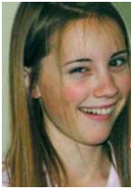
Depression in Children and Adolescents Case Example
http://www.abc.net.au/austory/specials/leastlikely/
Notes:
an excellent documentary about one adolescent’s depression

Slide 15
Depression in Children and Adolescents Medical Differential Diagnosis
Medications
Substances of abuse
Infections
Neurological disorders
Endocrine
Notes:
Medications: isotretinoin, corticosteroids and stimulants (e.g.,
amphtetamines, methylphenidate)
• Substances of abuse: amphetamines, cocaine, marijuana, solvents
• Infections: acquired immunodeficiency syndrome (AIDS),
monucleosis, influenza
• Neurologic disorders: epilepsy, migraine, traumatic brain injury
• Endocrine: Addison’s disease, Cushing’s disease, hypopituitarism,
thyroid disorders.

Slide 16
Depression in Children and Adolescents Important Psychiatric Distinctions
Unipolar vs. bipolar
Psychotic depression vs. schizophrenia
Depression vs. substance use
Depression vs. adjustment disorder with depressed mood
Depression vs. demoralization from disruptive disorders

Slide 17
Depression in Children and Adolescents Free Rating Scales*
CES-DC: Center for Epidemiologic Studies-Depression Scale
MFQ: Mood and Feelings Questionnaire
DSRS: Depression Self-Rating Scale
KADS: Kutcher Adolescent Depression Scale
PHQ-A: Patient Health Questionnaires-- Adolescent
SDQ: Strengths and Difficulties Questionnaire
*See eTextbook for hyperlinks
Notes:
Overall, self-report scales seem to be of limited use in pre-pubertal children but more helpful in adolescents. The impact of new technologies, such as cell phones, has not been fully exploited and may increase their utility. The majority of these scales are proprietary and costly but none has demonstrated a clear superiority over the others. Table E.1.6 lists some of the scales that are free of charge for clinical use; some are available in several languages.

Slide 18
Depression in Children and Adolescents Treatment Aims
Reduce symptoms and impairment
Shorten episode
Prevent recurrences

Slide 19
What works?
Depression in Children and Adolescents What Works?
Robust evidence of effectiveness for:
Medication (moderate and severe depression)
Psychotherapy (milder depression)
Cognitive behaviour therapy (CBT)
Interpersonal psychotherapy (ITP)

Slide 20
Depression in Children and Adolescents Principles of Management for All Cases
ALL PATIENTS
CONDUCT A RISK ASSESSMENT
ESTABLISH SEVERITY
[clinical assessment +depression rating scale]
SUPPORTIVE MANAGEMENT
-Build rapport
-Psycho-education
-Self-help
-Healthy lifestyle: exercise, sleep hygiene
-Supportive psychotherapy (problem solving, stress management, pleasant events)
Admission?

Slide 21
Depression in Children and Adolescents Treatment Options
Depending on severity:
Watchful waiting
Supportive management
Psychosocial interventions
Cognitive Behavioral Therapy (CBT)
Interpersonal Psychotherapy (IPT)
Medication

Slide 22
Depression in Children and Adolescents Evidence-Based Psychotherapy
Cognitive Behavioral Therapy (CBT)
Interpersonal Psychotherapy (IPT)
https://www.youtube.com/watch?v=DT6biKxqotw

Slide 23
Depression in Children and Adolescents Cognitive Behavioral Therapy
Identify links between mood, thoughts, activities
Challenge negative thoughts
Increase enjoyable activities
Build skills to maintain relationships
Notes:
The first goal of CBT is to help patients identify links between mood,
thoughts and activities in their lives (e.g., speaking to a friend on the phone
resulting in an improvement in mood) and challenge some of their negative
beliefs; at the same time the number of activities is increased using strategies such
as scheduling enjoyable activities. Optimally, this requires using a mood diary (see
Figure E.1.1). Another goal is to help the patient discriminate between helpful and
unhelpful thoughts, to develop strategies for generating more helpful thoughts,
and to practice using helpful thought patterns in response to stressful situations
(cognitive restructuring). The third goal is to equip the young person with skills to
build and maintain relationships, undermined by the adolescent’s depression, by
training in social skills, communication and assertiveness.

Slide 24
Depression in Children and Adolescents Interpersonal Psychotherapy
Similar to CBT
Focus on the present
Premise=Interpersonal conflicts→ loss of social support→ depression
Improvement of interpersonal skills
Psychoeducation about depression
Increase enjoyable activities
Notes:
IPT has many commonalities with CBT. For example, the goals are to link
mood with interpersonal events happening at the time, to provide psychoeducation
about depression, and to encourage prticipation in enjoyable activities (especially
at school) as a means to feeling better. However, the focus is on interpersonal
issues (e.g., examining and modifying maladaptive communication patterns and
interpersonal interactions) and on teaching the adolescent how to deal with them
constructively.

Slide 25
Depression in Children and Adolescents Medication
Strong placebo effect
Evidence different for adults
Key aspects for informed consent
Undertreatment is common
Most evidence for Selective Serotonin Reuptake Inhibitors (SSRIs)
Fluoxetine: approved >8 year olds
Escitalopram: approved for adolescents in
the US
Notes:
A key aspect of prescribing and of obtaining informed consent is to discuss
with the patient, and family if appropriate, the reasons for the medication, the
possible adverse effects (including emergence or escalation of suicidal thinking,
nervousness, agitation, irritability, and mood instability), the need to take
medication as prescribed, and the delayed action of antidepressants (to dampen
expectations of immediate benefit). Good practice also recommends reviewing the
patient at weekly intervals (personally or over the phone) for the first month once
medication is prescribed. These reviews allow further supportive management and
monitoring of side effects and response (by the administration at each visit of a
depression rating scale).

Slide 26
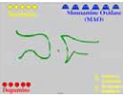
Depression in Children and Adolescents How Anti-Depressant Medication Works
https://www.youtube.com/watch?v=m4PXHeHqnmE
Notes:
A key aspect of prescribing and of obtaining informed consent is to discuss
with the patient, and family if appropriate, the reasons for the medication, the
possible adverse effects (including emergence or escalation of suicidal thinking,
nervousness, agitation, irritability, and mood instability), the need to take
medication as prescribed, and the delayed action of antidepressants (to dampen
expectations of immediate benefit). Good practice also recommends reviewing the
patient at weekly intervals (personally or over the phone) for the first month once
medication is prescribed. These reviews allow further supportive management and
monitoring of side effects and response (by the administration at each visit of a
depression rating scale).

Slide 27
Depression in Children and Adolescents Adverse Side Effects of SSRIs
Suicidality*
Manic switch
Akathisia
Agitation
Irritability
Disinhibition
Nightmares/sleep disturbances
Gastrointestinal
Weight gain
Sexual
Bleeding
Possible congenital
Withdrawal syndrome
Serotonin Syndrome
Notes:
*It has been suggested that, paradoxically, SSRIs may induce suicidal behavior
in the young. Ascertaining whether this is true is not easy because depression also
increases suicide risk. So far, data are contradictory. On the one hand, pharmacoepidemiological
and ecological studies suggest that increased use of SSRIs may
have resulted not on an increase but on a lessening in youth suicide. On the other
hand, a review by the FDA of controlled trials with more than 4400 children and
adolescents showed a robust if small (2%) short-term increase in the incidence of
suicidality (suicidal thoughts, attempts) in those receiving antidepressants, mostly
SSRIs, compared with placebo. There were no suicides. This resulted in the FDA
and regulatory bodies in other countries warning of this risk.

Slide 28
Depression in Children and Adolescents Other Treatments
Electroconvulsive therapy (ECT): good evidence of effectiveness in severe cases
Transcranial Magnetic Stimulation (TMS)
Light Therapy (in seasonal mood disorder)
Complementary and Alternative Medicine (CAM)
St. John’s Wort
Omega 3 Fatty Acids
S-Adenosyl Methionine (SAMe)
Exercise

Slide 29
Depression in Children and Adolescents Management of Acute Unipolar Depressive Episode
Mild: supportive management, CBT, or IPT→no response→CBT, IPT, or antidepressant medication
Moderate: supportive management, CBT, IPT or medication→ no response–add medication
Severe: CBT/IPT and medication
Psychotic depression: CBT/IPT and medication and second generation antipsychotic drug

Slide 30
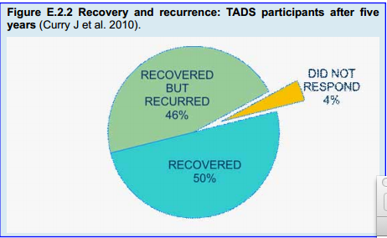
Depression in Children and Adolescents Management of Depressive Episode: Duration of Treatment
Notes:
It has already been highlighted that depression in the young is an illness that
tends to recur. In the TADS follow up, for example, almost half (47%) of those
who recovered had a recurrence by 5 years. Adolescents who had responded poorly
in the short term, females and those with comorbid anxiety disorder were more
likely to have a new episode. However, recurrence rates were the same irrespective
of the treatment provided (e.g., those who received fluoxetine combined with
CBT did not seem to obtain an extra benefit) (Curry et al, 2010). Treatment of a
recurrence should be the same as for the acute episode. Frequent recurrences may
require ongoing treatment with an antidepressant.

Slide 31
Depression in Children and Adolescents Management of Bipolar Depressive Episode*
1st Line: lithium carbonate or quetiapine
2nd Line:
--lithium or valproate with an SSRI
--olanzapine and an SSRI, or
--lamotrigine
No evidence for antidepressants alone
Lithium and valproate should be avoided in women of childbearing age
Notes:
*There is little evidence available to guide treatment in young people.
Recommendations are therefore extrapolated from adult data (Frye, 2011).
• Initial treatment (first line) would usually be lithium carbonate or
quetiapine
• Second line treatments would be:
(a) a combination of lithium or valproate with an SSRI
(b) olanzapine and an SSRI, or
(c) lamotrigine.
• There is no evidence that antidepressants alone (without a mood
stabiliser) are helpful and are not recommended due to risk of a manic
switch or of induction of rapid cycling.
• Lithium and valproate should be avoided in women of childbearing
age (teratogenic).

Slide 32
Depression in Children and Adolescents Which Antidepressant?
Two considerations: effectiveness and safety
SSRIs are safest
Fluoxetine is most effective
Begin fluoxetine
Start with 10mg of fluoxetine
Increase to 20mg after one week
20mg for pre-pubertal children
30 or 40mg for adolescents
If not fluoxetine try another SSRI (e.g., sertraline or escitalopram)
Continue treatment 6 months after recovery

Slide 33
Depression in Children and Adolescents Treatment Resistance
Determining treatment resistance
Handling treatment resistance
Possible causes:
Patient factors
Family factors
Environmental factors
Clinician factors
Notes:
Despite the importance of this matter there is very limited empirical data
on treatment-resistant depression in youth and no agreed definition. Birmaher
and colleagues (2009) proposed the following definition of treatment resistance:
a youth whose symptoms of depression and functional impairment persist after
8-12 weeks of optimal pharmacological treatment or 8-16 sessions of IPT or CBT and a further 8-12 weeks of an alternative antidepressant or augmentation therapy
with other medications or evidence-based psychotherapy. That is, treatment
resistance should be diagnosed only after two trials of evidence-based treatment at
an adequate dose and for an appropriate duration (e.g., 12 weeks).
--Patient factors: Younger age, Severe depression, Poor short-term response, Poorer functioning, Appetite or weight Disturbance, Sleep disturbance, Poor adherence, Comorbid psychiatric or medical conditions, Side effects, Medications (e.g steroids)
--Family factors: Maternal depression, Lack of cooperation, Unreliability, Mistreatment, conflict, Psychopathology (e.g.,
drug and alcohol)
--Environmental factors: Bullying, Stressors, Dysfunctional school
or neighborhood, Antisocial peer group, Cultural/ethnic issues
--Clinician factors: Misdiagnosis, Inappropriate treatment(non-evidence-based treatment, inadequate dose or not for long
Enough), Non-recognition of side effects, Poor doctor-patient therapeutic relationship

Slide 34
Depression in Children and Adolescents Cross-Cultural Differences
Afghanistan
Japan
China
Turkey
Hispanic populations
Notes:
There are many case reports about cultural differences in the manifestation of
depression. For example, depressive symptoms in Afghanistan are similar to those
in other countries but in Afghanistan the majority of depressed patients express
passive death wishes rather than active suicidal thoughts. Despite suggestions that a
higher incidence of guilt feelings in Western countries is due to the influence of the
Judeo-Christian religion, when different religions are compared, the presence or
absence of guilt feelings is associated with the level of education and the degree of
depression rather than with religious background (Inal-Emiroglu & Diler, 2009).
Japanese patients do not describe depression in the same way as Americans, nor
do they express feelings in the same way. For the Japanese, concrete images from
nature allow personal emotions to be expressed impersonally; as a result, they often
lack a personal reference or connection when expressing emotions. Rather than
as feelings of guilt or low mood, depression is frequently experienced in somatic
terms in Hispanic populations. Clinicians must be aware that depressed Hispanic
youth may present with headaches, gastrointestinal and cardiovascular symptoms, or complaints of “nerves”. Many Chinese people when depressed do not report
feeling sad; they complain of boredom, feelings of inner pressure, pain, dizziness,
and fatigue and often find a diagnosis of depression morally unacceptable and
meaningless.

Slide 35
Depression in Children and Adolescents Barriers to Care
Shortage of child psychiatrists and allied professionals
Few training programs
Stigma
Few medications
Minimal inpatient facilities

Slide 36
Depression in Children and Adolescents Prevention
Cognitive restructuring
Social problem-solving
Interpersonal communication skills
Coping
Assertiveness training
Notes:
Overall, outcome of prevention programs has been mixed. Targeted (selective
and indicated) programs show small to moderate effect sizes but greater than those
of universal programs, which have been found to be largely ineffective. The most
efficacious programs focus on cognitive restructuring, social problem-solving,
interpersonal communication skills, coping, and assertiveness training individually
or in groups. Prevention programs are typically conducted with groups of children
or adolescents in school or clinic settings (Garber 2009; US Preventive Services
Task Force, 2009).

Slide 37
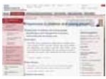
Depression in Children and Adolescents Further Information
American Academy of Child and Adolescent Psychiatry
(AACAP) 2007 Practice Parameter on depressive disorders
http://www.jaacap.com/article/S0890-8567(09)62053-0/pdf
National Institute for Health and Clinical Excellence
(NICE) (2005) guidelinehttp://www.nice.org.uk/guidance/cg28 - guidelinereview
Notes:
Overall, outcome of prevention programs has been mixed. Targeted (selective
and indicated) programs show small to moderate effect sizes but greater than those
of universal programs, which have been found to be largely ineffective. The most
efficacious programs focus on cognitive restructuring, social problem-solving,
interpersonal communication skills, coping, and assertiveness training individually
or in groups. Prevention programs are typically conducted with groups of children
or adolescents in school or clinic settings (Garber 2009; US Preventive Services
Task Force, 2009).

Slide 38
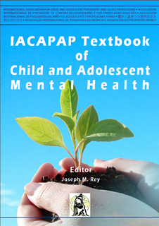
Depression in Children and Adolescents Thank You!

